Slide 1
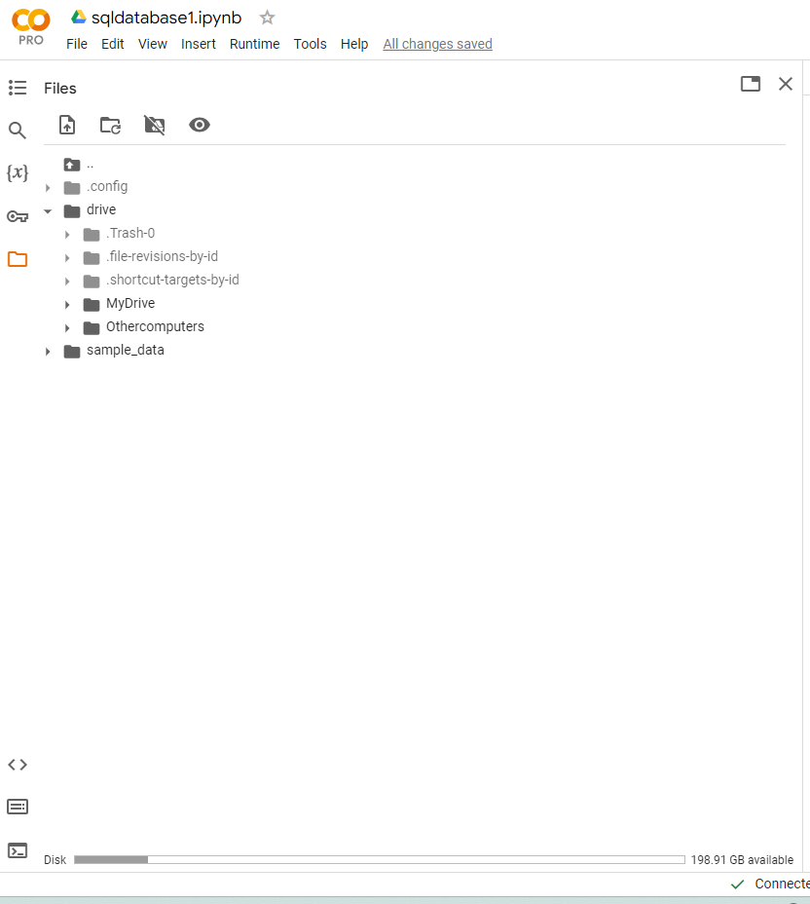
INITIALIZING THE GOOGLE COLAB NOTEBOOK

Slide 2
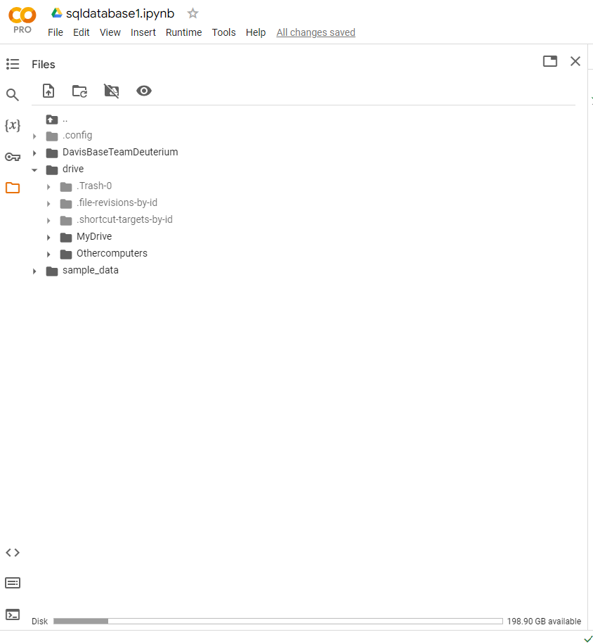
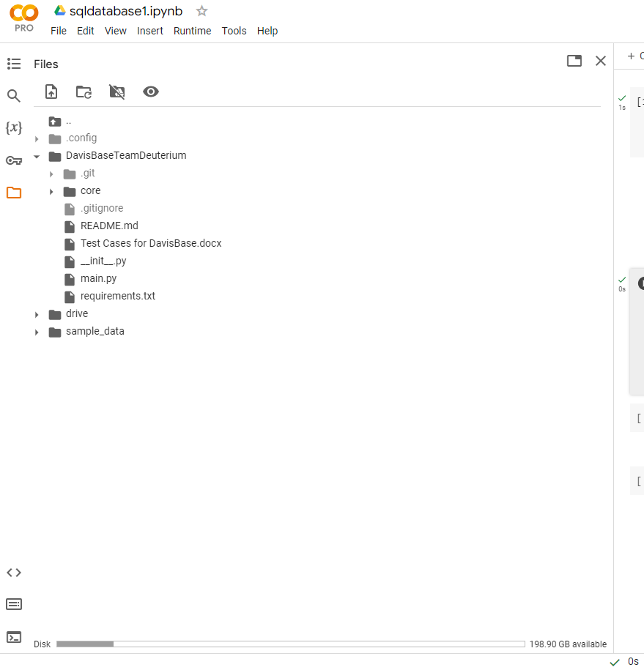
IMPORTING THE DATABASE FILES USING GITHUB CLONE
After expanding the explorer view to see the content of the main directory named ‘DavisBaseTeamDeuterium’

Slide 3
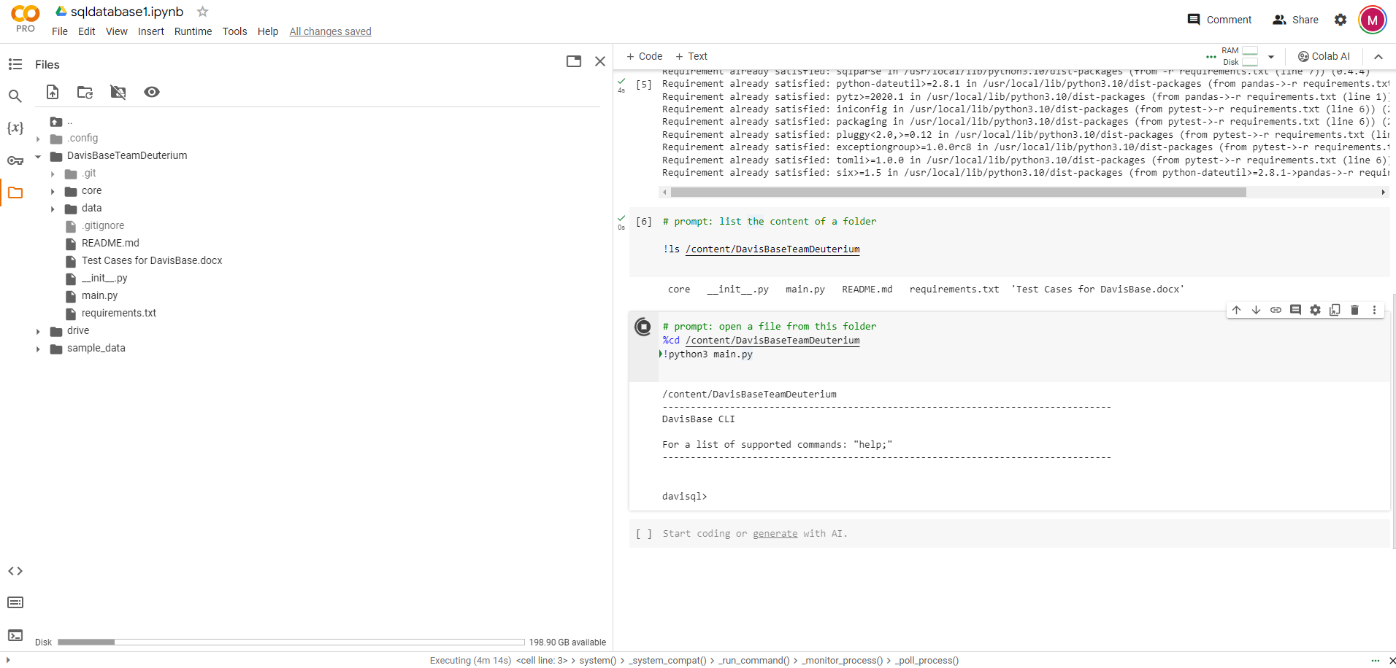
INITIALIZING THE MAIN.PY AND DAVISQL>

Slide 4
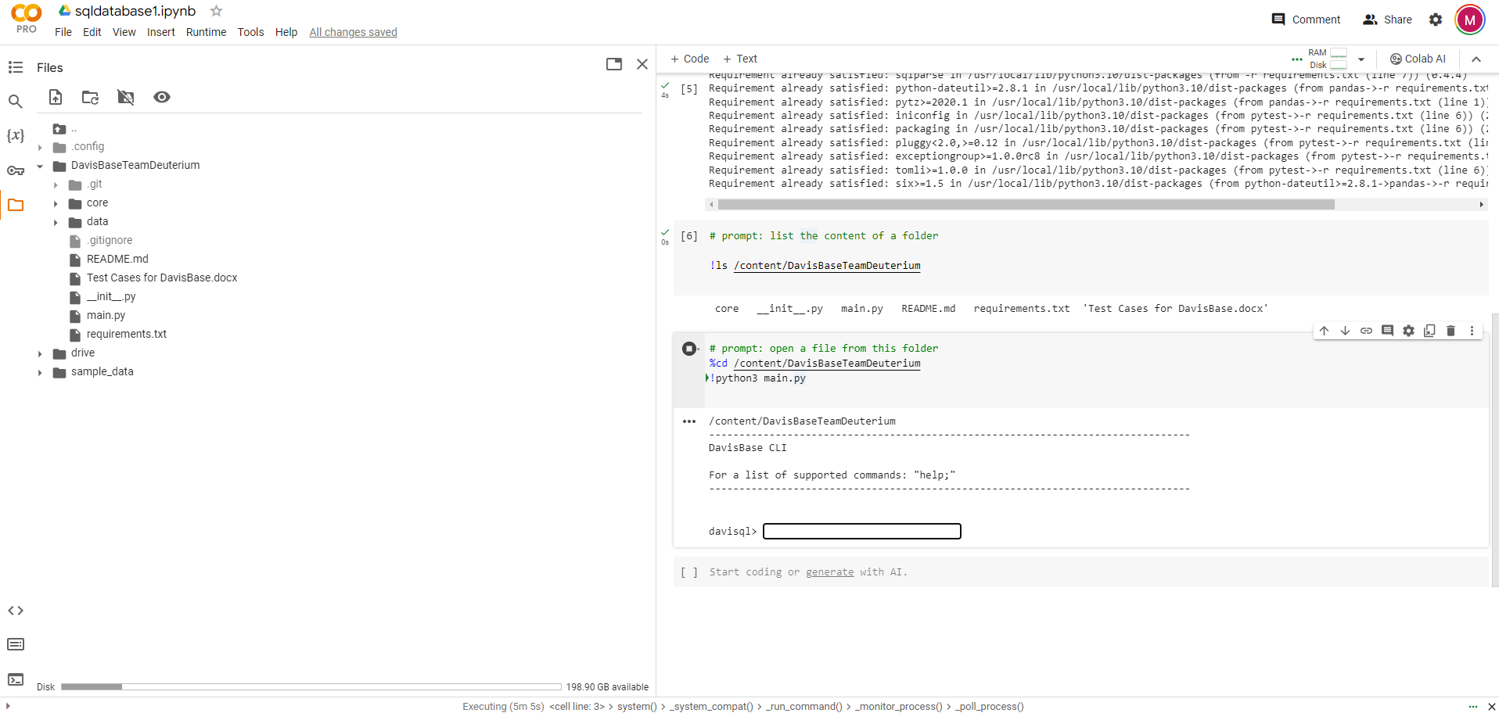
INITIALIZING THE MAIN.PY AND DAVISQL>

Slide 5
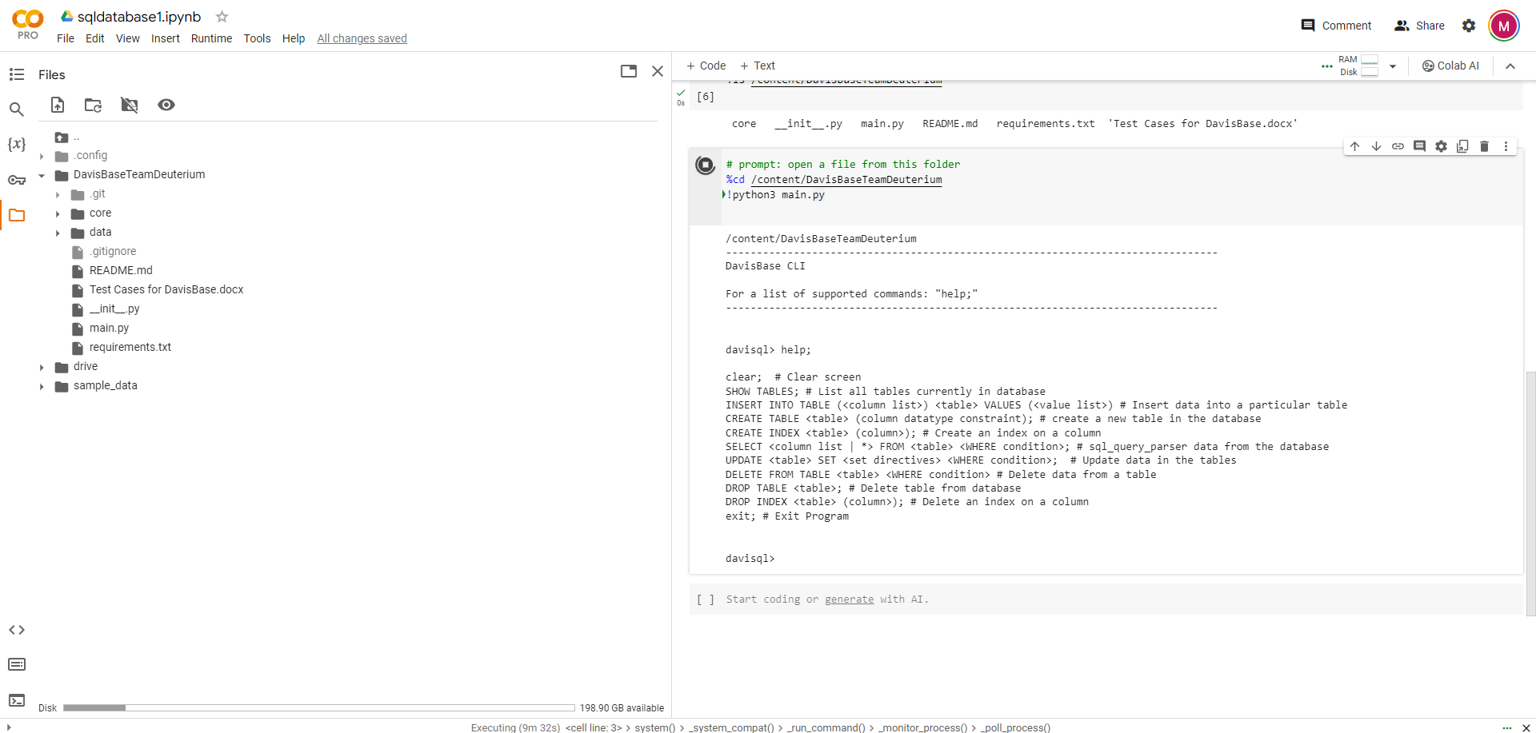
IMPLEMENTING HELP; ON DAVISQL>

Slide 6
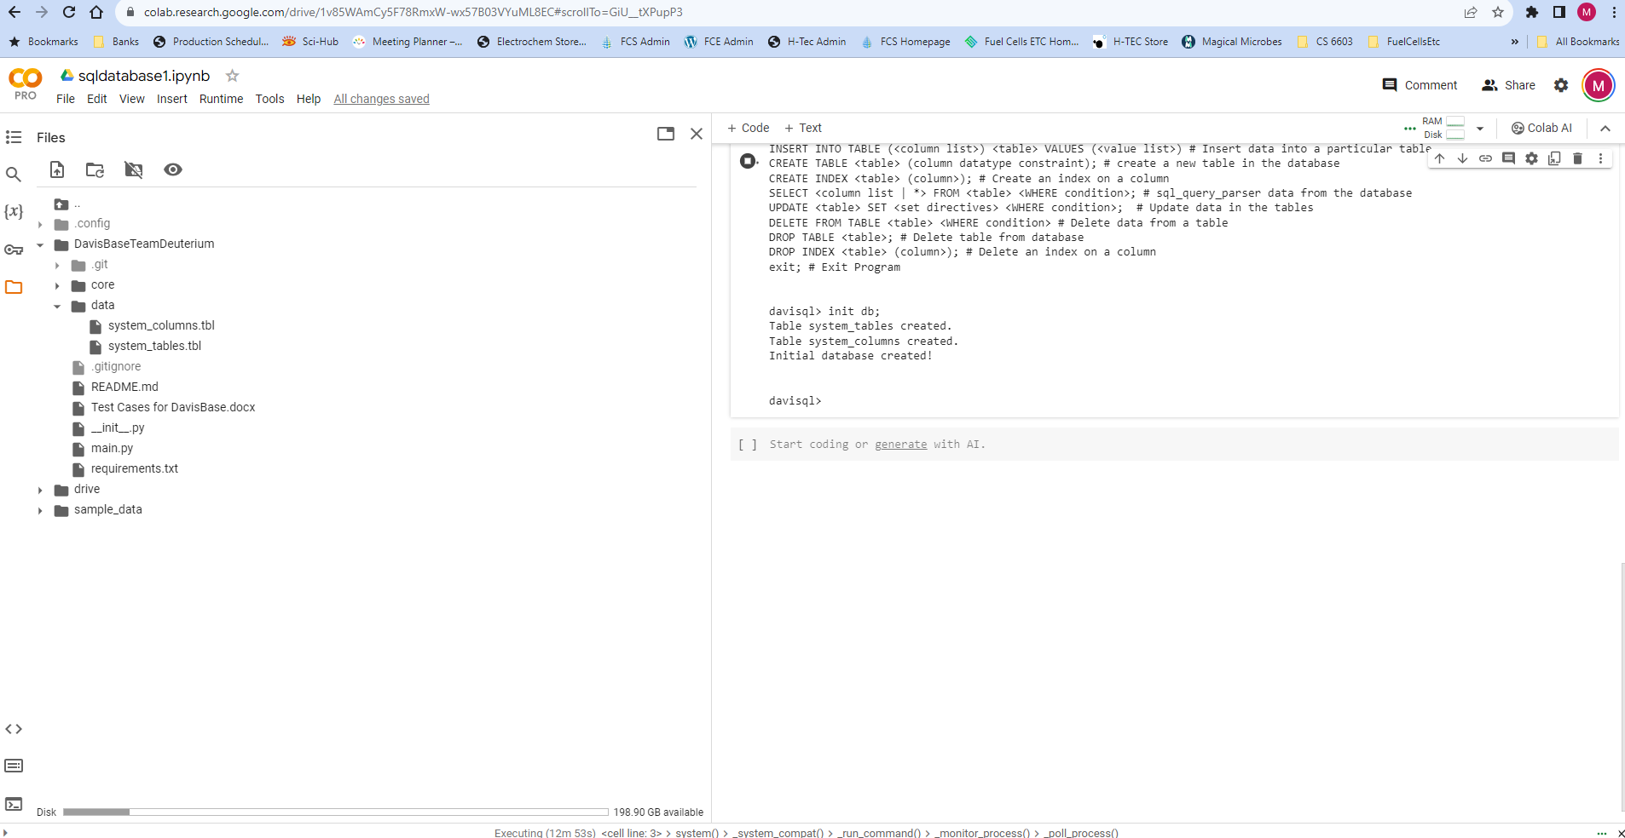
IMPLEMENTING INIT DB; ON DAVISQL>

Slide 7
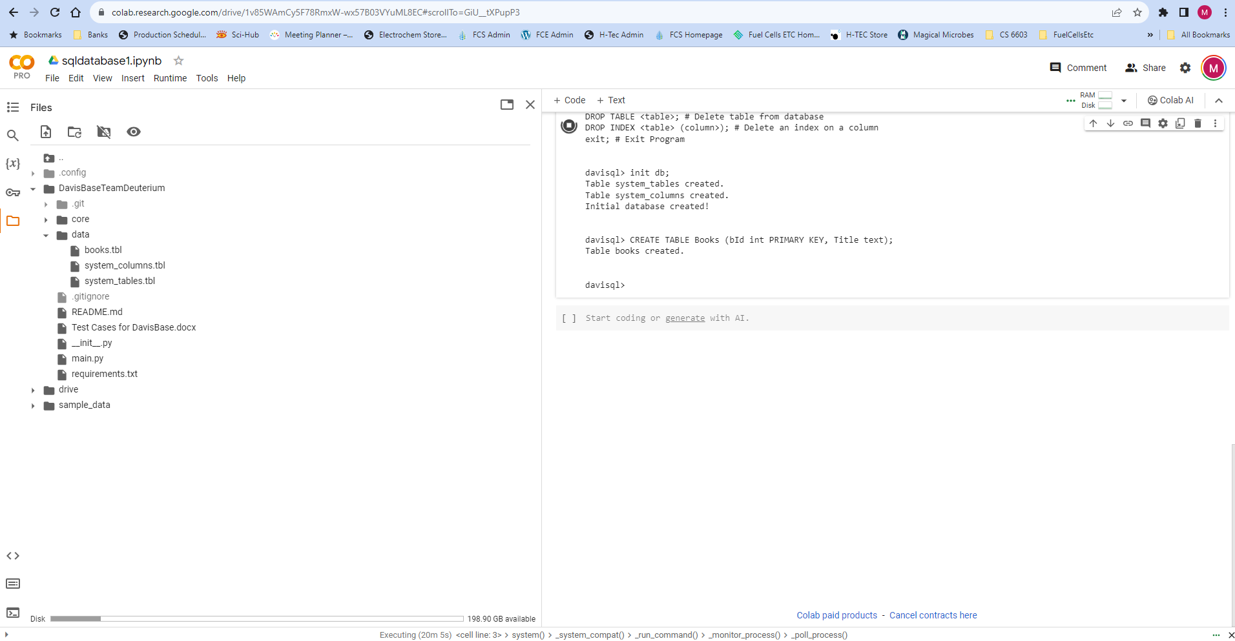
TEST CASE 1. Create table Books, check if books.tbl file created in data folder successfully

Slide 8
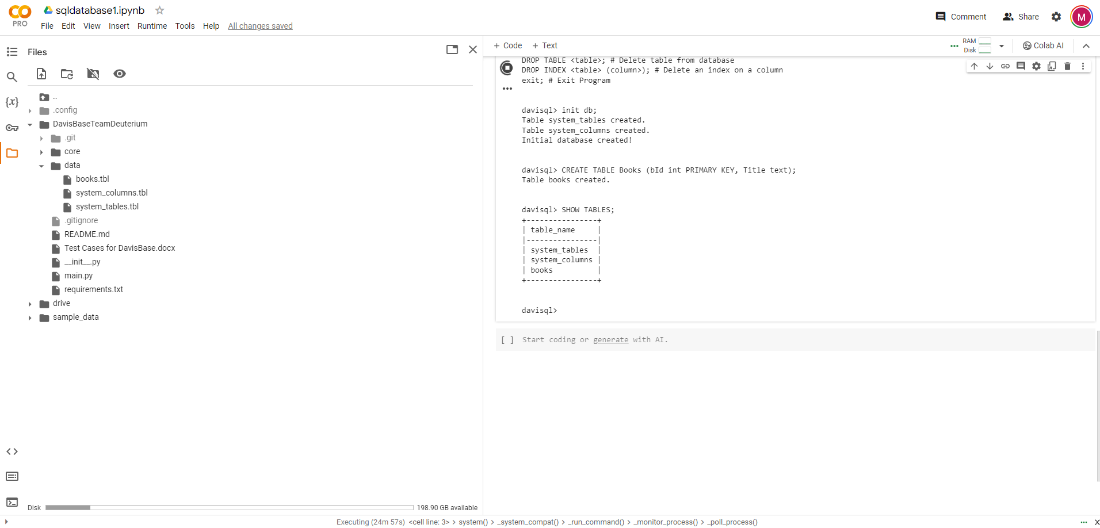
TEST CASE 2. Show tables: shows all tables in the database

Slide 9
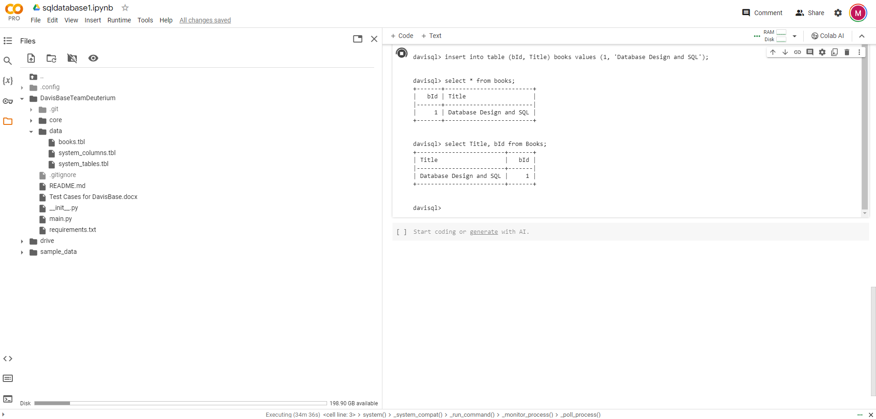
TEST CASE 3. (1) Insert values into table books, then check if values insered in ‘books.tbl’ file and (2) then select * from ‘books’ and see if data is displayed successfully or (3) select Title, bId from ‘books’ and see if data is displayed successfully

Slide 10
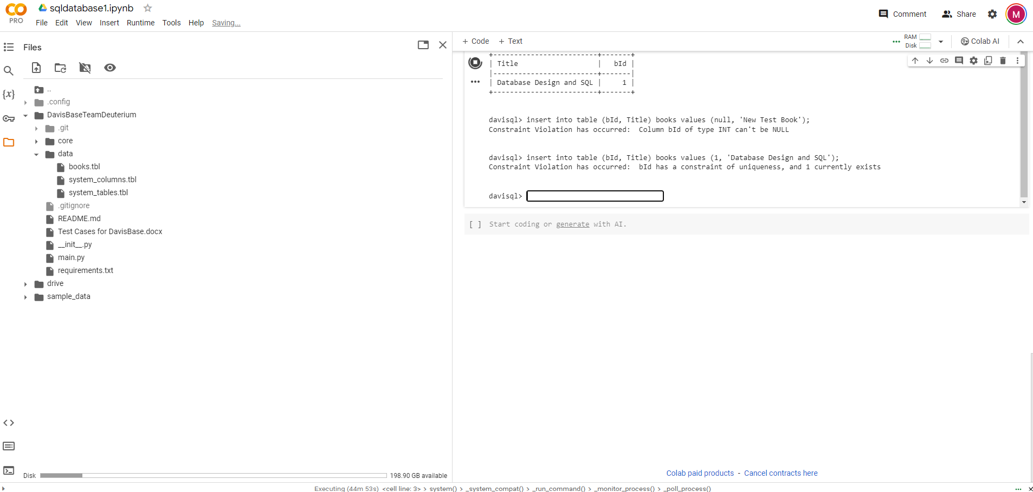
TEST CASE 4. Insert values in the table ‘books’ by repeating the unique/primary key and then check if appropriate exception is thrown

Slide 11
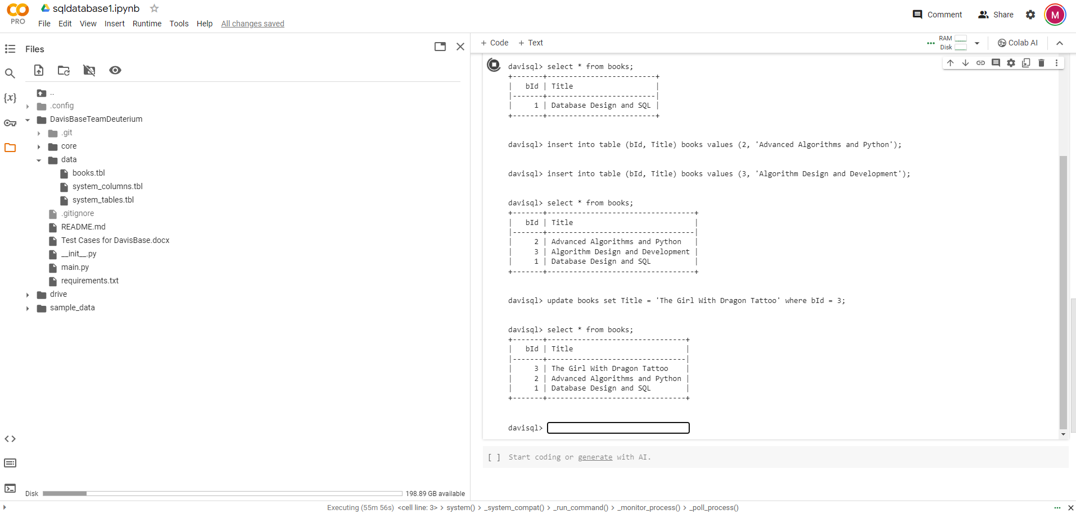
TEST CASE 5. Perform Update operation on ‘Books’ and check if data is updated successfully

Slide 12
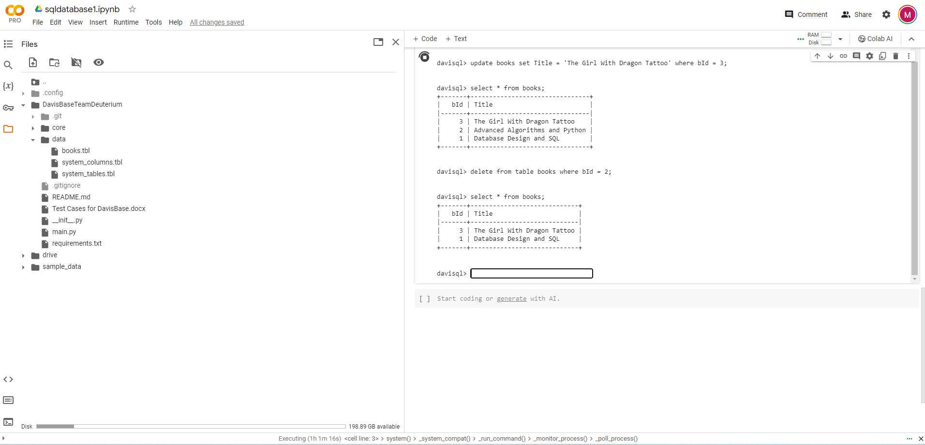
TEST CASE 6. Perform Delete Operation

Slide 13
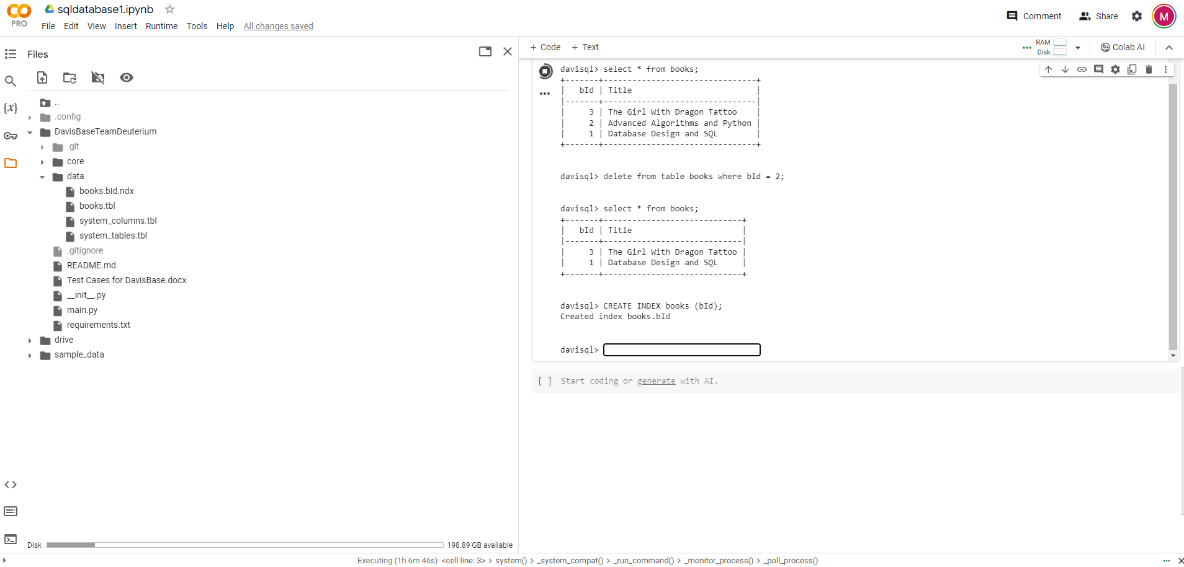
TEST CASE 7. Add Index to table books

Slide 14
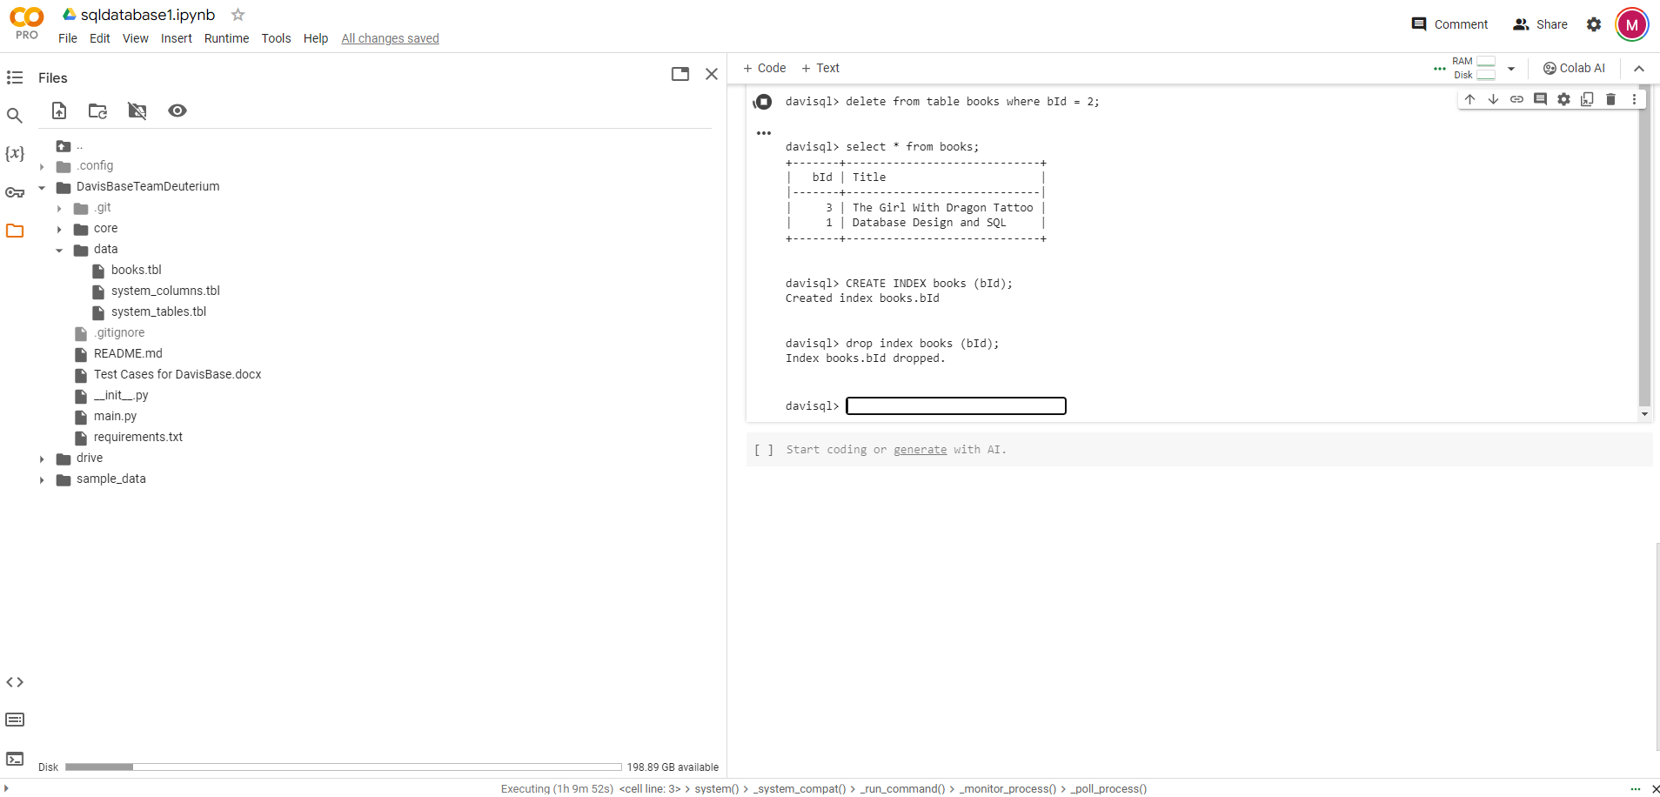
TEST CASE 8. Drop Index on table books

Slide 15
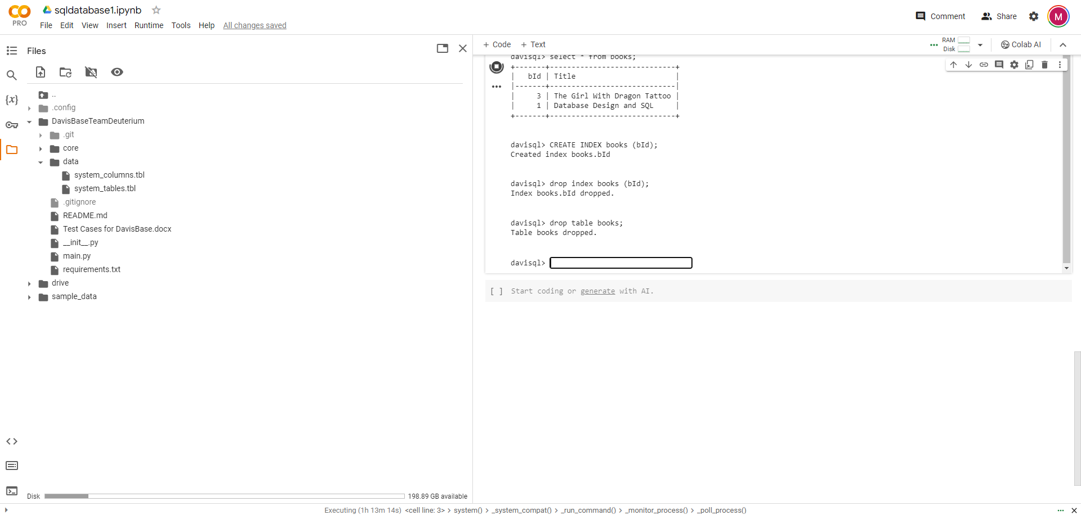
TEST CASE 9. Perform Drop Table operation and validate if the table is deleted from the database and removed from the data folder

Slide 16
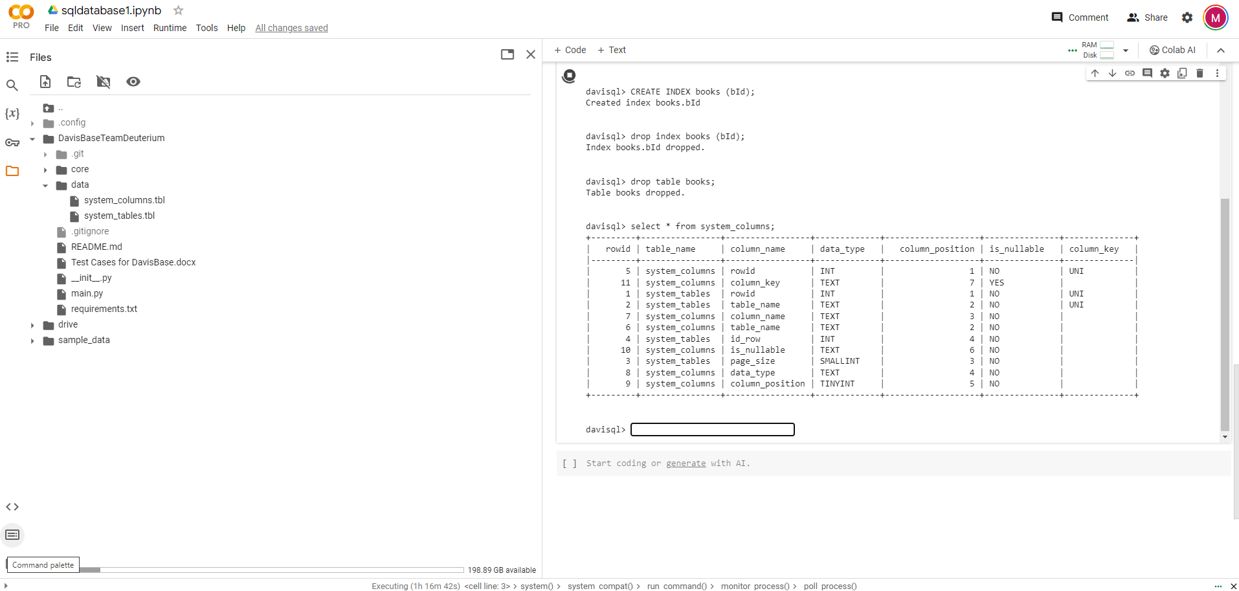
TEST CASE 10. Perform select * from system_columns operation

